Slide 1
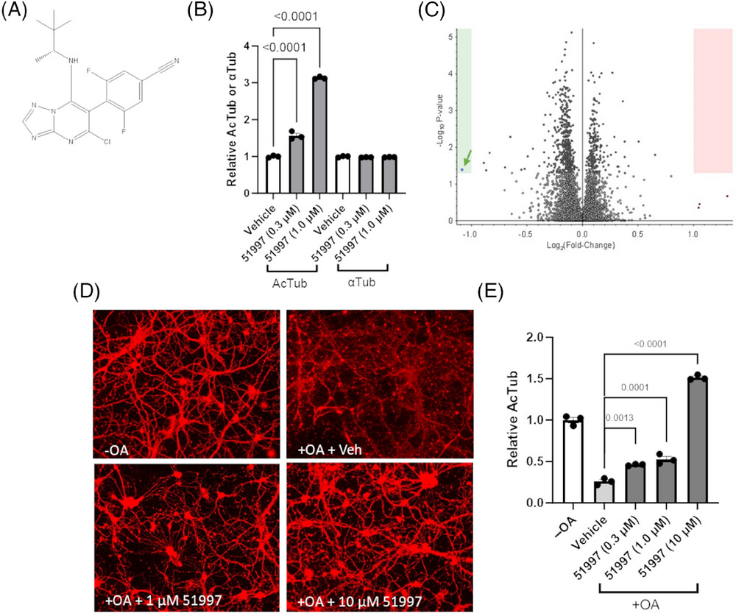
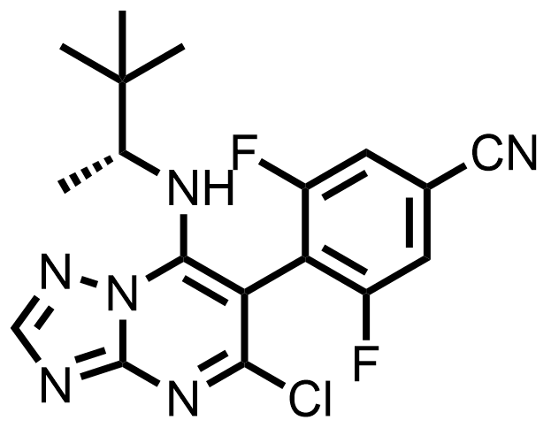
(A)
CNDR-51997
LogD_{7.4} : 3.6
B/P : 0.7
Oral Bioavailability : F=76%
Half life in brain : 1.8 h
MED : 1 mg.kg⁻¹
MTD : 20 mg.kg⁻¹

Slide 2
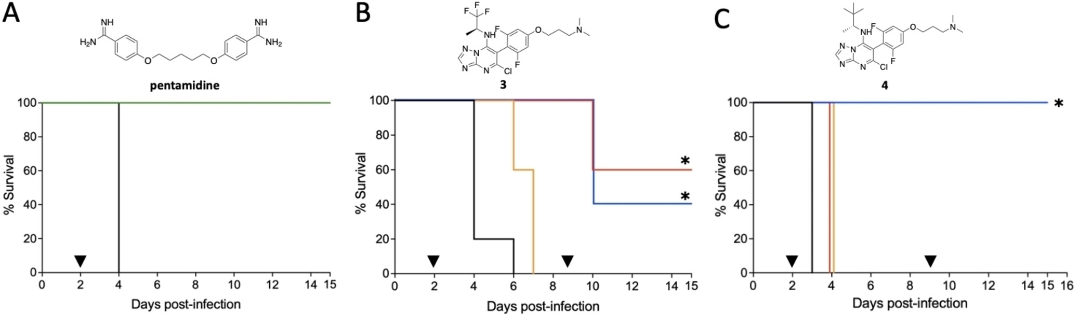

Slide 3
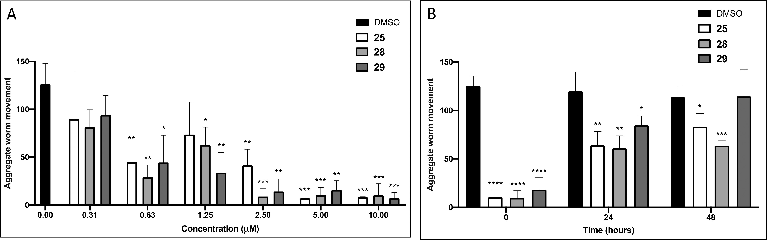
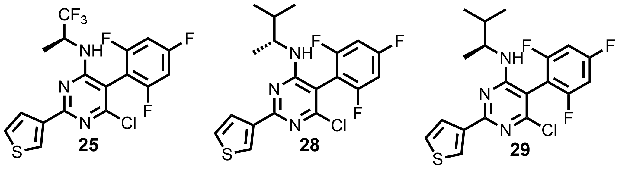

Slide 4
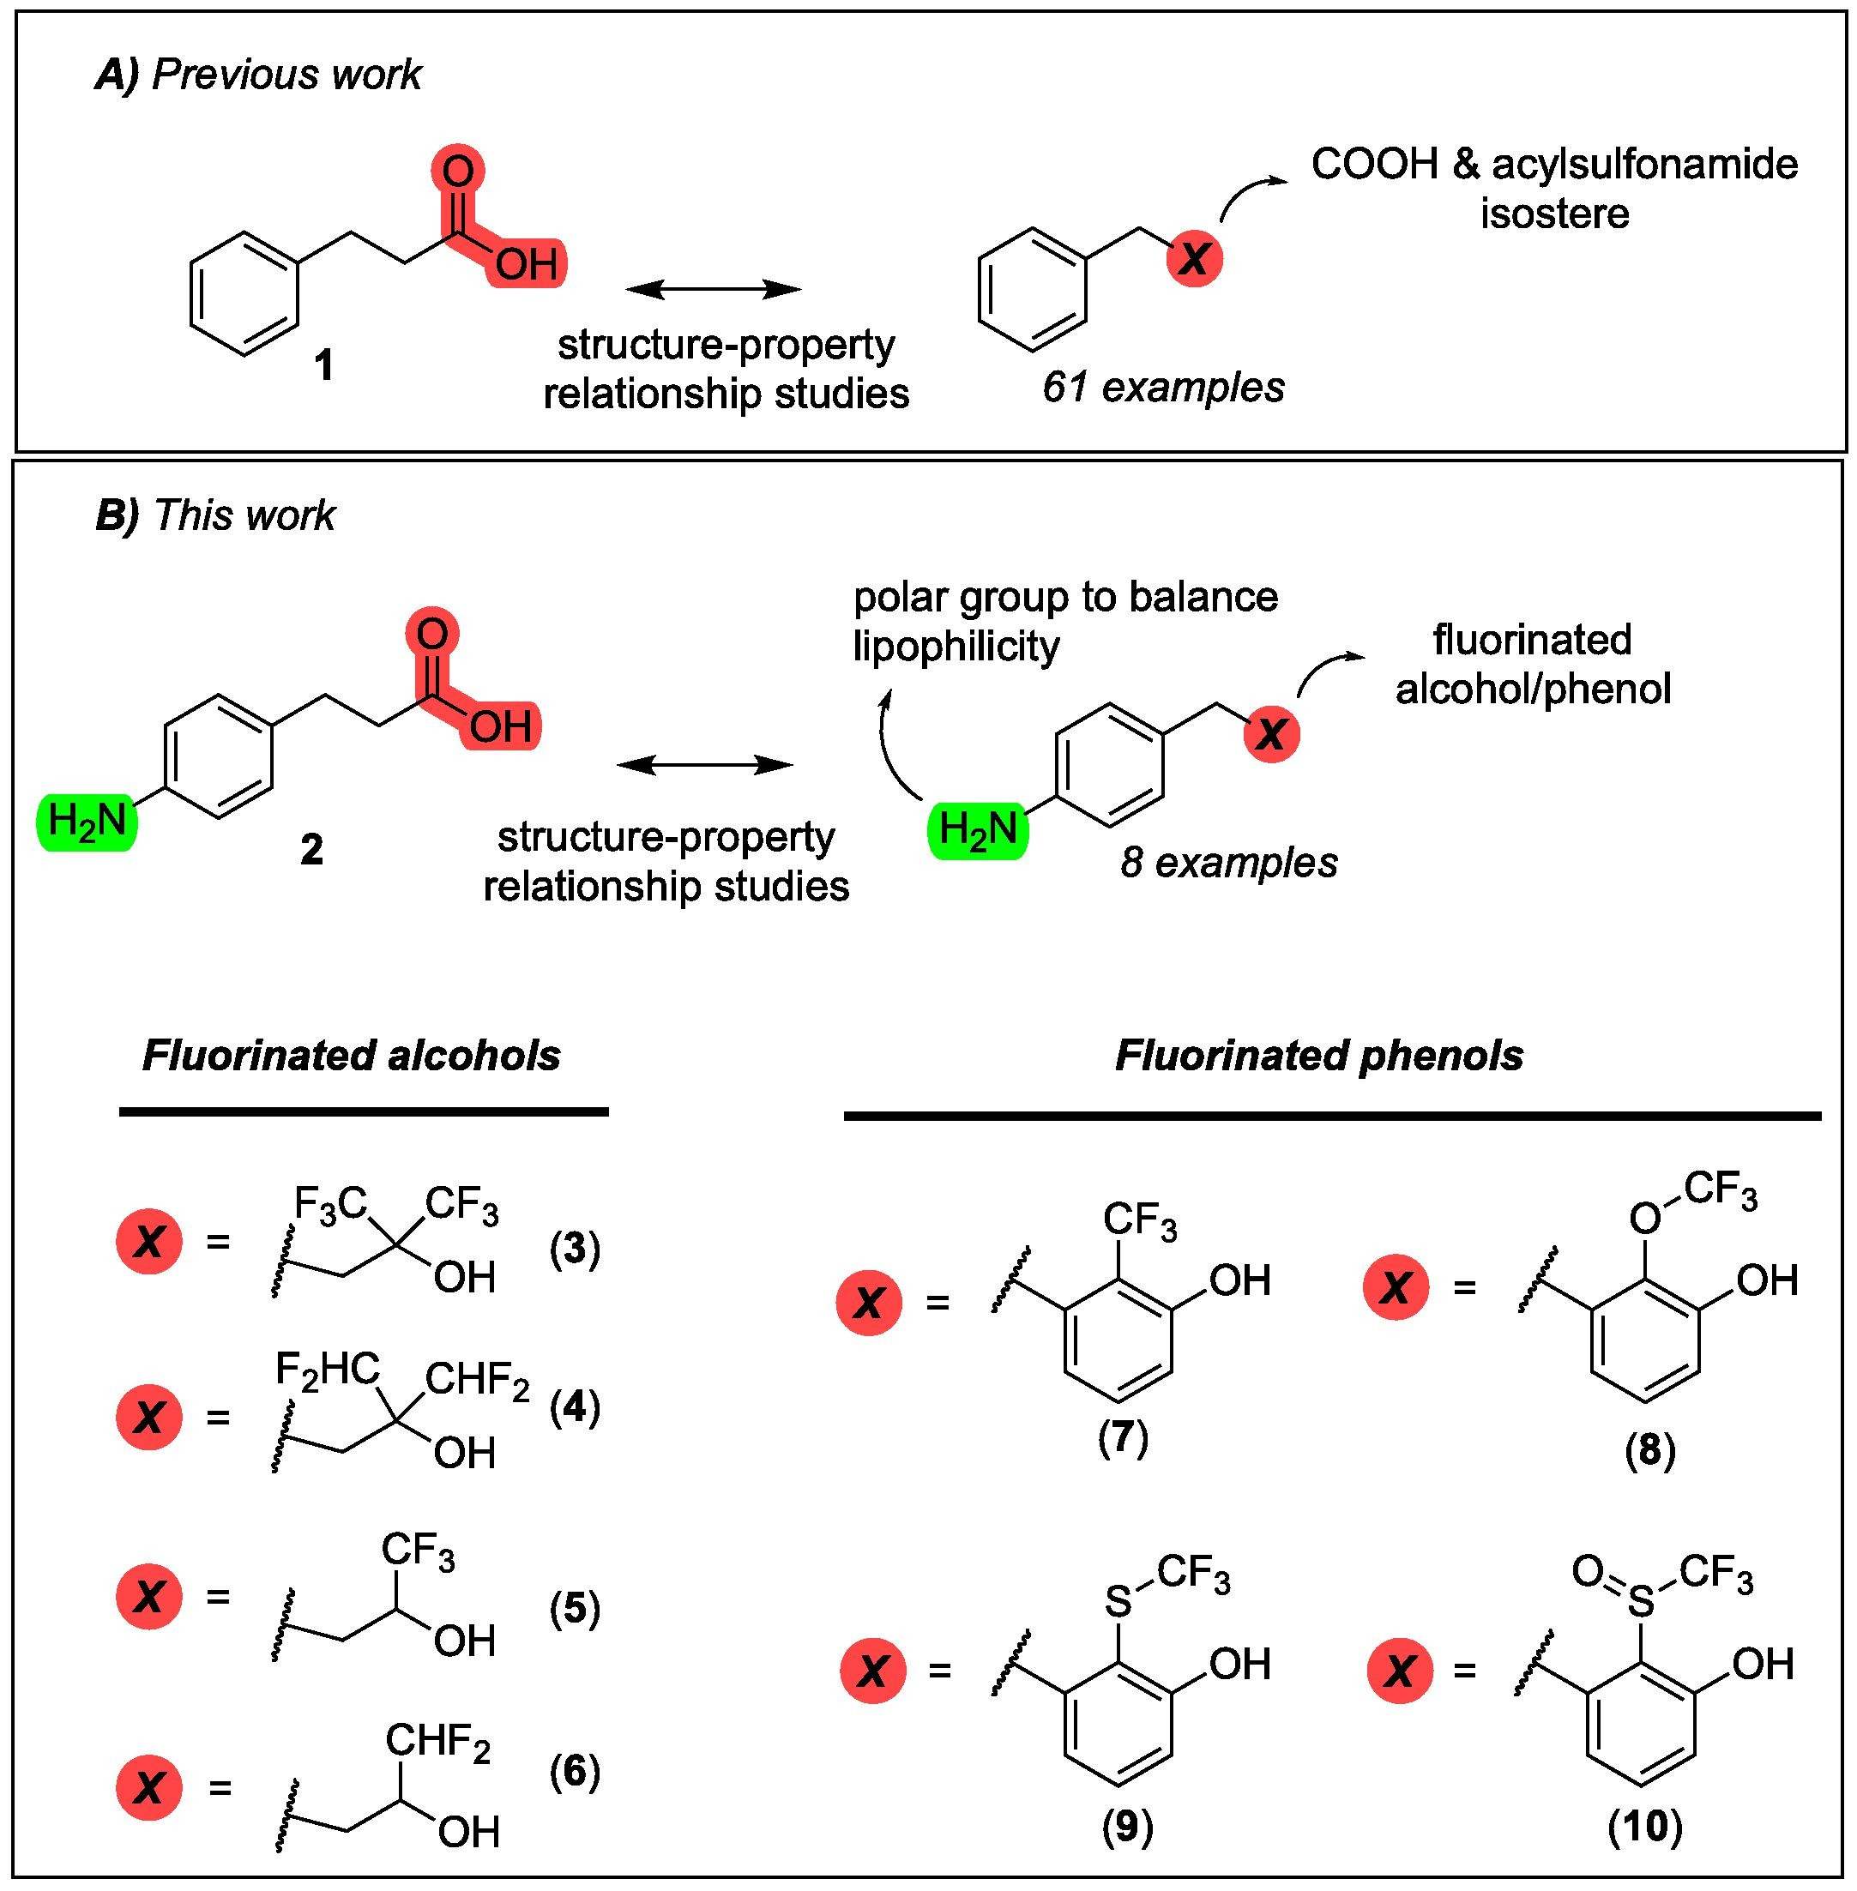
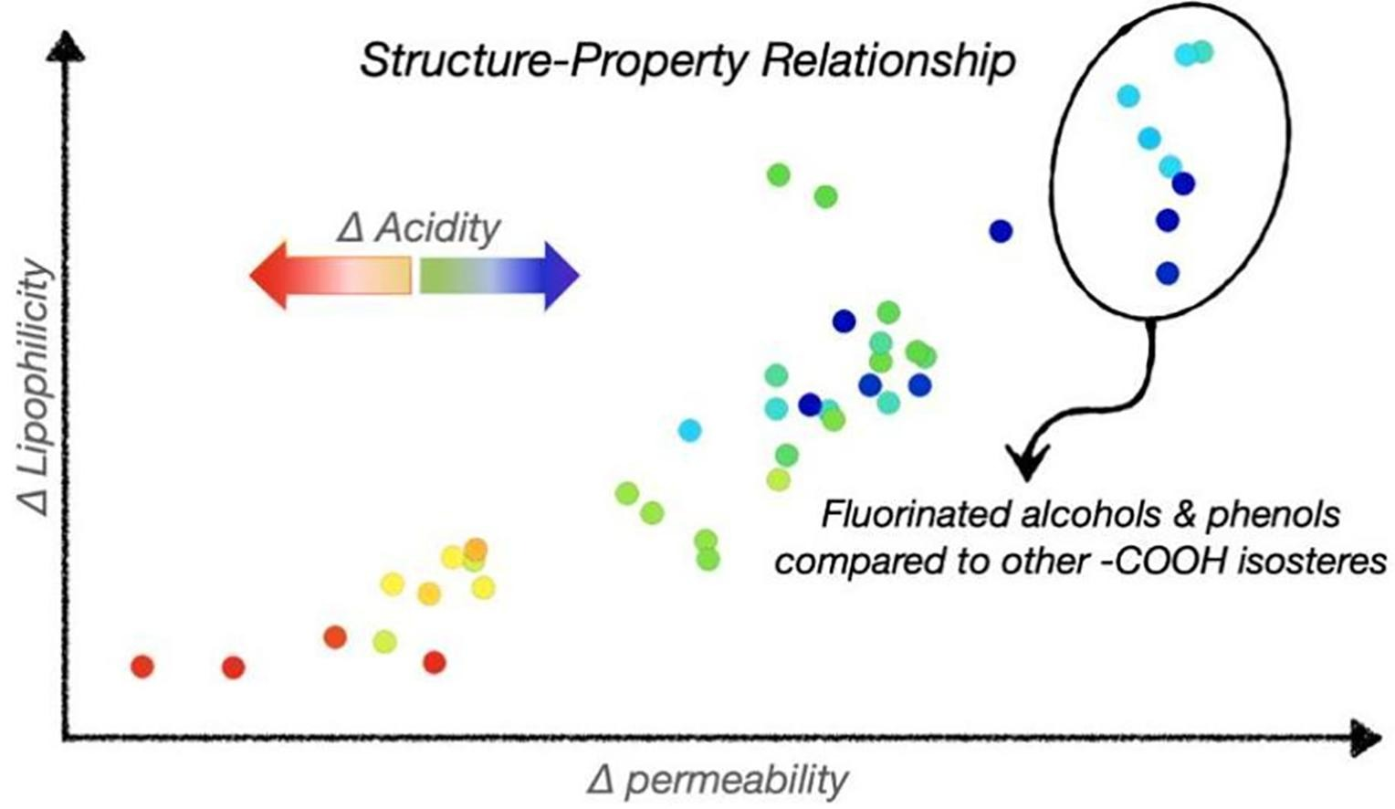
Ballatore lab historical work

Slide 5
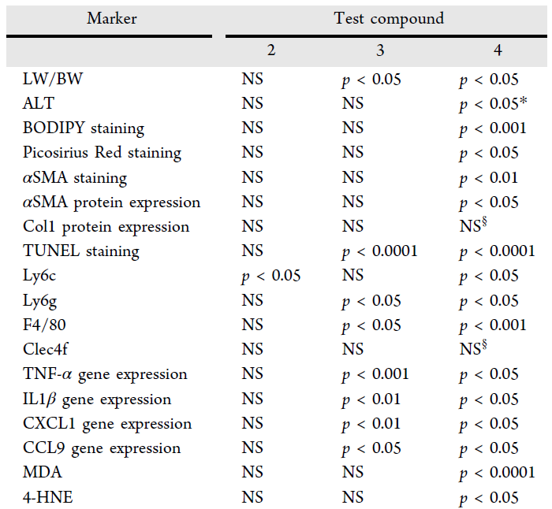
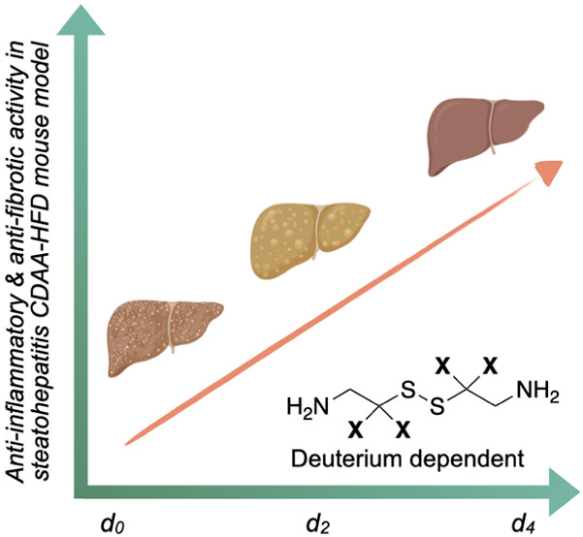
cystamine
D2-cystamine
D4-cystamine

